Slide 1


MPPG (Multidisciplinary Program Planning Group)
Update
ACS Meeting in Philadelphia, August 21-25, 2016
Christine Landry-Coltrain
Alternate Councilor – POLY

Slide 2
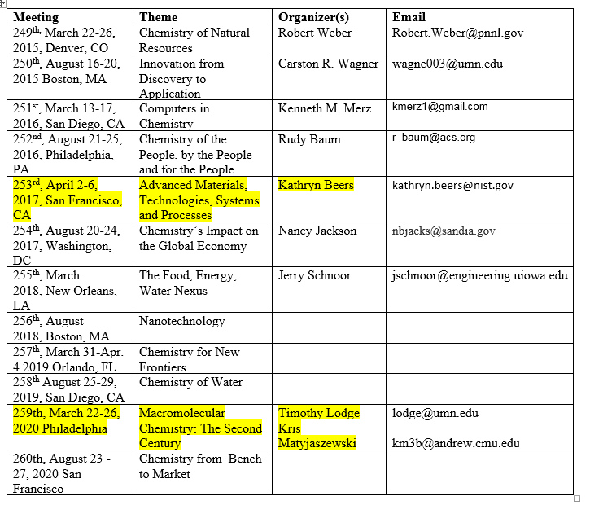
National Meeting Themes and Organizers
Reminder of upcoming POLY involvement in MPPG at National Meetings

Slide 3
POLY proposed the following Thematic Programming for ACS Spring 2020:
Macromolecular Chemistry: The Second Century
Organizers: Timothy Lodge and Kris Matyjaszewski
Divisions Directly Related: POLY, PMSE, Colloid and Surface, Cellulose and Renewable Materials, Industrial and Engineering, Rubber
Other Closely Related Divisions: Biological Chemistry, Catalysis Science and Technology, Environmental Chemistry, Organic Chemistry, Physical Chemistry
The year 2020 marks the centenary of the landmark paper by Hermann Staudinger, entitled “Über Polymerisation” (“On Polymerization”), in which he demonstrated the preparation of high molar mass compounds by repetition of standard small molecule synthetic steps.* His proposed concept of “macromolecules” had already received heavy criticism, but this paper marked the beginning of an era characterized by rational design and synthesis of polymers. By 1953 Staudinger’s work had been recognized by the Nobel Prize in Chemistry, and the chemical industry had long since embraced large scale polymerization for the commercial production of a host of new and now ubiquitous synthetic materials, including Nylon, synthetic rubber, polyethylene, Plexiglas, and Teflon that are found in countless products that have had tremendous impact across a broad swath of technologies. For the past half century polymers have dominated the chemical industry in the US, and worldwide, with use and expansion into new markets growing unabated. The intellectual richness of macromolecular science has also become apparent across the spectrum of chemistry. The contributions of organic chemistry and inorganic chemistry to the preparation of polymers, the contributions of physical chemistry to the understanding of their behavior, to the impact macromolecules have in the world of chemical biology are hard to overstate. It would be entirely apropos to recognize this class of chemical compounds, which encompasses all plastics, rubbers, fibers, adhesives, all proteins, DNA, RNA, and the most abundant natural materials, including cellulose, hemicellulose, and lignin.
*Staudinger, H. (1920). "Über Polymerisation". Ber. Deut. Chem. Ges. 53 (6): 1073. doi:10.1002/cber.19200530627

Slide 4
Motivations for Divisional involvement in Thematic Programming
Thematic Programming (TP):
Advantages to the Divisions include:
  enhanced advertising
  money available for thematic programming, specific registrations, associated outreach, collaborations, coffee breaks (not sure if these need to be in Convention Center, but I would think so, as the aim is to promote interdisciplinary interactions) at the discretion of the organizer (who get ~$30k)
  co-organization and cross-listing of symposia with other divisions
  ability to organize an OUTREACH event (usually on Saturday in concert with Presidential event) involving the community
Many Divisions do not take advantage of this; how can we engage Divisions?

Slide 5
How can POLY become engaged?
Divisions should reach out to the thematic organizer of the specific meeting and ask for $$ for specific ideas, ask what is available – need to do this a few years in advance
  Co-program with other Divisions, and ask for sponsorship from the thematic organizer (Kate Beers is the thematic organizer for San Francisco, SP2017)
  “I (Kate) should have some resources to distribute to help support co-operative functions across Division in the Theme areas: catalysis, manufacturing with emphasis on microprocesses and biomanufacturing, functional materials, sustainability, ‘start-up’ chemistry and education/outreach via materials chemistry research (e.g. industry needs, societal challenges, international)”
Divisions should “self promote” newsworthy symposia and talks that are aligned with the meeting Theme to the organizer. – ACS will promote these via the Web and Social media Apps
Volunteer opportunity: The MPPG committee is requesting nominations from the Divisions for the positions of 2018 MPPG Chair-Elect and At-Large Representative.
Continual need for suggestions from the Divisions for Kavli Emerging Lecturer and Kavli Innovations in Chemistry Series

Slide 6
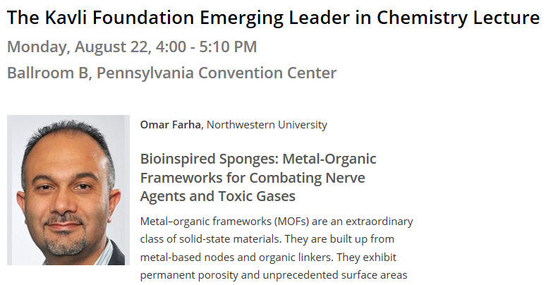
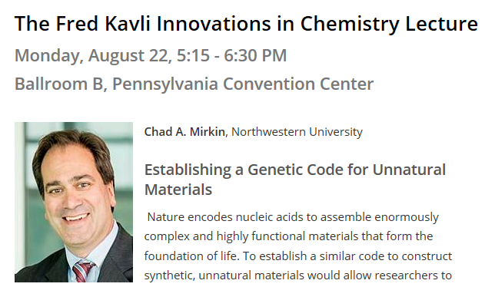
Kavli Speakers at the Fall 2016 ACS meeting

