Slide 1


Current Membership
August 4,447
March 2016 4,178
January 2016 4,254
July 2015 4,246
March 2015 4,296
January 2015 4,302
July 2014 4,452
February 2014 4,394
January 2014 4,489
July 2013 4,587
March 2013 4,706
January 2013 4,886
August 2012 4,967
March 2012 4,846
January 2012 4,977
August 2011 5,111
March 2011 5,145
January 2011 5,300
August 2010 5,095
March 2010 5,414
Dec. 2009 5,677
August 2009 5,858
January 2009 6,193
July 2008 5,557
January 2007 6,604
Total Members 4,447
789 Students
3,197 Members
461 Affiliates
History Affiliates Students Regular
2016 Fall 461 789 3,197
2016 Spring 322 720 3,136
2015 Fall 233 826 3,186
2015 Spring 259 738 3,299
2014 Fall: 235 799 3,418
2014 Spring: 149 828 3,417

Slide 2
Membership Demographics
Years of Service
1 1,487
2 372
3 255
4 174
5 151
6-10 379
11-15 304
16-20 358
21-25 289
26-30 212
31-35 224
36-40 95
41-45 69
46-50 78
2,439
Total 4,447

Slide 3
New Membership Activity
POLY Calendar
  Interactive Calendar
  POLY staff to enter events
  Available to ALL
  Includes meetings, activities, awards, not only POLY activity
https://teamup.com/ksc26b7c6f43d85c99
POLY Tie/Scarfs

Slide 4
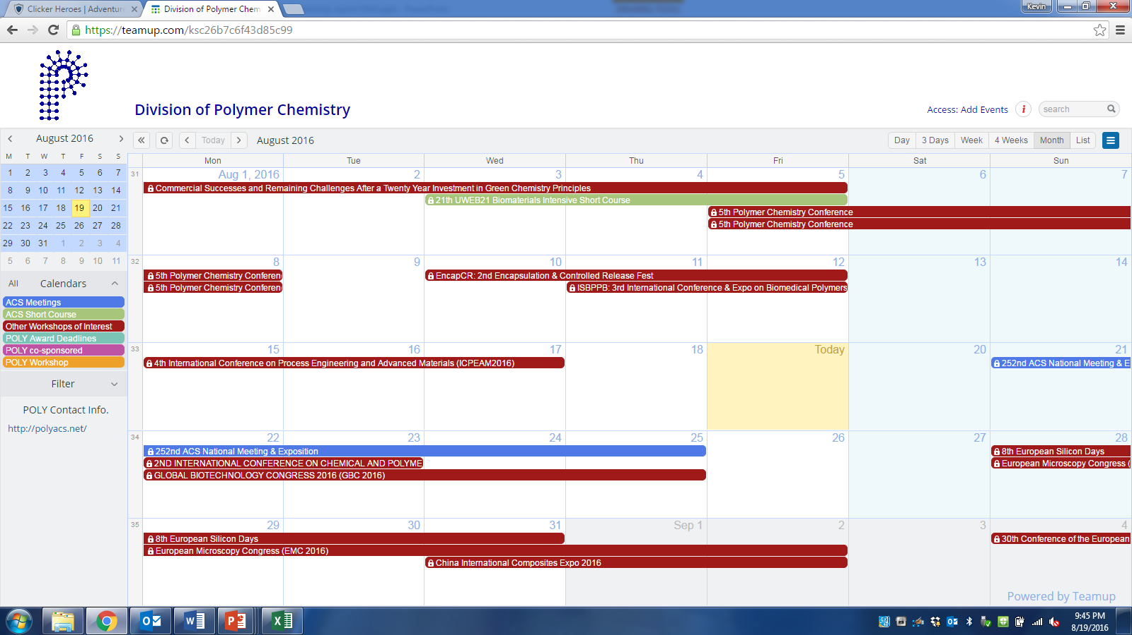
POLY CALENDAR

Slide 5
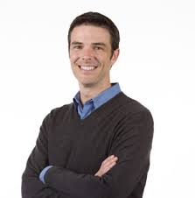
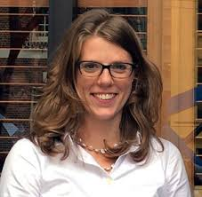
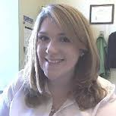
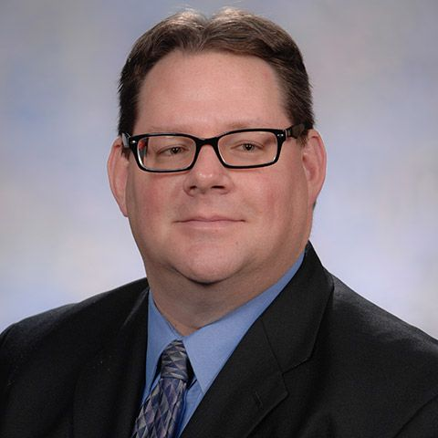
STUDENT CHAPTERS COMMITTEE
Recruitment
Happy Hour
Brent Sumerlin (UF)
Emily Pentzer - CWRU
Student Chapter Reports
PMSE Representative
Sara Orski – NIST
Dan Savin (UF)

Slide 6
STUDENT CHAPTERS
Welcome to the newest PMSE/POLY student chapter at Virginia Tech!
Current Active Chapters:
University of Florida
University of Michigan
University of Minnesota
University of South Carolina
University of Southern Mississippi
University of Akron
Virginia Tech
Leads on Future Chapters:
FSU – Justin Kennemur
Florida A&M - Subramanian Ramakrishnan
MIT
UMASS-Amherst
Univ. of New Hampshire
Univ. of Iowa
UCLA
Current Inactive Chapters:
Working with new faculty advisors on revitalizing chapters
Clemson University – Marek Urban & Steve Creager
Case Western Reserve University
University of Delaware
University of Texas – Dallas

Slide 7
STUDENT CHAPTER REPORTS
2016 Student Chapter Reports will be due in January 2017
Panel of non-academic POLY/PMSE members will read and rate reports and choose the most outstanding chapter for a $500 award
Reports will include current chapter roster and a summary of chapter efforts in 2016 regarding member education, community outreach, career development, and social activities
Official due date for reports will be announced in the fall. Report forms will be available on the PMSE/POLY student chapter websites

Slide 8
STUDENT CHAPTER PROGRAMMING IDEAS
Student Chapter Symposium –
Opportunity to gain experience and perspective on how to organize a meeting
One half-day symposium at a future ACS meeting
Student chapters write a proposal on symposium title and topic
One chapter is chosen to organize a symposia –
- invite speakers
- read abstracts for submitted talks & choose speakers
- advertise
- get sponsorships (support from POLY/PMSE as line item in membership budget or through programming?)
- give introductory remarks and moderate session
get feedback from faculty advisor and POLY/PMSE panel (3 people) after meeting
aim for ACS Washington DC (Fall 2017) or ACS New Orleans (Spring 2018)
Dates: call for proposals = Oct 2016, proposals due = Jan 2017, selected chapter April 2017
Continue with student happy hour/networking opportunities at national meetings
Notes:
Fall 2017 or spring 2018 meeting depends on whether ACS poly centrally funds the symposium or if the student symposium asks for programming funds like any other symposium

