Slide 1


Current Membership
March 2016 4,178
January 2016 4,254
July 2015 4,246
March 2015 4,296
January 2015 4,302
July 2014 4,452
February 2014 4,394
January 2014 4,489
July 2013 4,587
March 2013 4,706
January 2013 4,886
August 2012 4,967
March 2012 4,846
January 2012 4,977
August 2011 5,111
March 2011 5,145
January 2011 5,300
August 2010 5,095
March 2010 5,414
Dec. 2009 5,677
August 2009 5,858
January 2009 6,193
July 2008 5,557
January 2007 6,604
Total Members 4,178
723 Students
3,206 Members
325 Affiliates
History Affiliates Students Regular
2016 Spring 322 720 3,136
2015 Spring: 233 826 3,186
2014 Spring: 149 828 3,417
400+ Recently Submitted

Slide 2
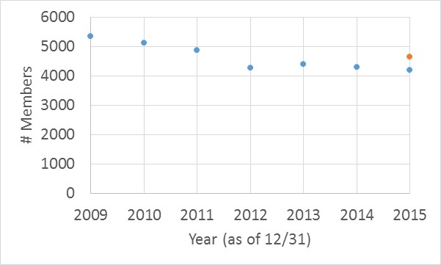
D
EMOG
R
A
P
H
I
C
S
POLY MEMBERSHIP
Blue – from ACS demographic reports
Orange – Estimated Upper Bound from POLY business office

Slide 3
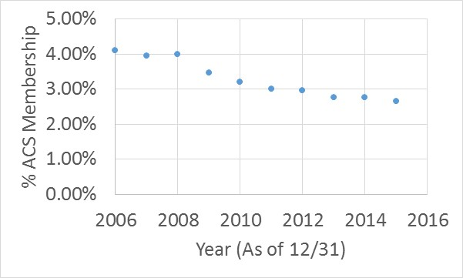
D
EMOG
R
A
P
H
I
C
S
% OF TOTAL ACS MEMBERSHIP

Slide 4
D
EMOG
R
A
P
H
I
C
S
FROM THE BUSINESS OFFICE…
Current membership – 4,254
Additional 400 members reported to ACS from business office
Members directly through business office
Workshops – 475
Scan Grant offer – 14
Free Memberships – 283 (121 from fall meeting)
TOTAL – 772

Slide 5
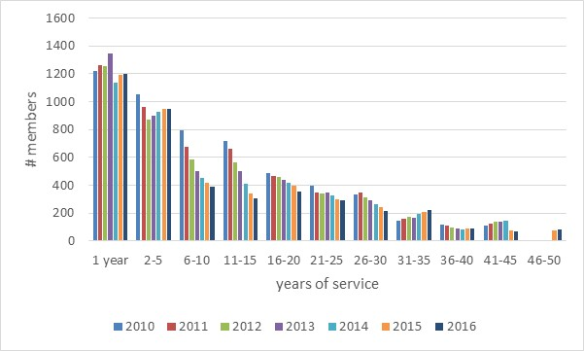
D
EMOG
R
A
P
H
I
C
S
YEARS OF SERVICE (1/31 EACH YEAR)

Slide 6
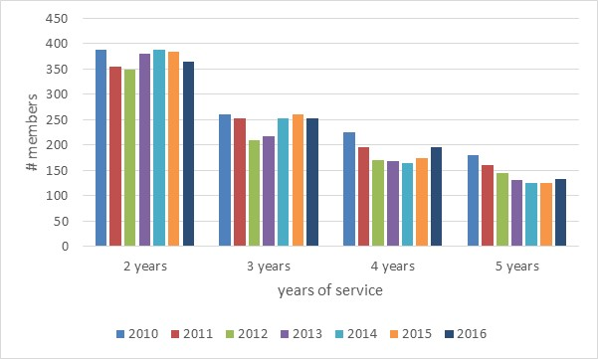
D
EMOG
R
A
P
H
I
C
S
YEARS OF SERVICE (1/31 EACH YEAR)

Slide 7
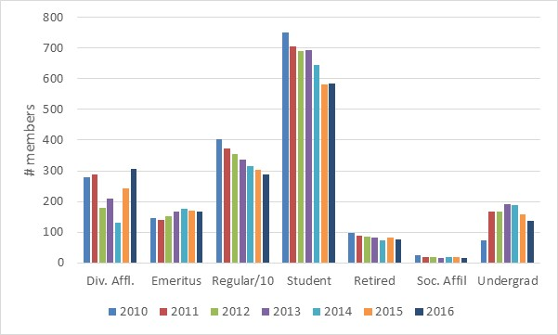
D
EMOG
R
A
P
H
I
C
S
MEMBERSHIP TYPE

Slide 8
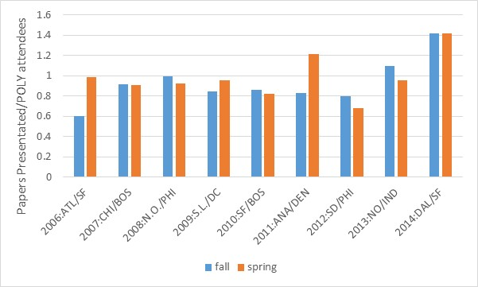
D
EMOG
R
A
P
H
I
C
S
MEMBERSHIP TYPE
Is Programming key to attracting attendees outside our membership and
building # at the meeting?

Slide 9
2
0
1
6
I
N
I
T
I
A
T
I
V
E
S
Objective: Reconstitute Membership Committee
The current membership committee is,
Kevin Cavicchi, Michael Meador, Mary Ann Meador, Alan Hopkins
Need to recruit at least two new members, one industry, one academia
Current Activities
Student membership activities are strong
Free memberships attracting members at meetings
Long range goals of membership committee
Timely maintenance of membership website
Recruiting – Maximize the use of Ffree 1st year memberships
Membership drives Universities, Industries, Regional Meetings
– set up a recruiting packet (send out on request or with meeting sponsorship)
Local Meetings – Potential IPG

Slide 10
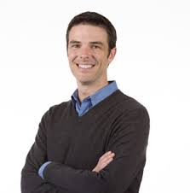
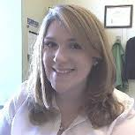
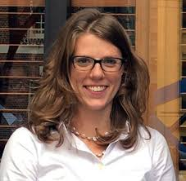
S
T
UD
E
N
T
C
HA
P
T
E
R
S
WHO DOES THE WORK?
Student Chapter Reports
Best Student Chapter Award
Recruitment
Happy Hour
Sara Orski – NIST
Brent Sumerlin (UF)
Emily Pentzer - CWRU

Slide 11
S
T
UD
E
N
T
C
HA
P
T
E
R
S
STUDENT CHAPTER REPORTS
SCHOOL | Award | 2015 Members |  |  | New members
 |  | TOTAL | POLY | PMSE | POLY | PMSE
Univ. of Florida* | $500 | 35 | 16 | 6 | 1 | 1
Univ. of Michigan | $200 | 52 | 7 | 12 | 9 | 9
Univ. of Minnesota | $200 | 43 | 12 | 6 | 26 | 26
Univ. of South Carolina | $200 | 14 | 9 | 7 | 6 | 6
Univ. of Southern Mississippi | $200 | 32 | 8 | 5 | 8 | 8
* University of Florida awarded best student chapter 2015 ($500 more)
CHAPTERS THAT DID NOT FILE REPORTS
Clemson University
Case Western Reserve University
University of Delaware
University of Texas – Dallas
Plan – work with faculty advisor/student
to engage chapter in POLY/PMSE
Deactivate if no report for two years
NEW CHAPTERS/LEADS
Univ. of Akron – Paperwork filed 3/2016
MIT
UMASS-Amherst
Univ. of New Hampshire
Univ. of Iowa
UCLA
Virginia Tech.

Slide 12
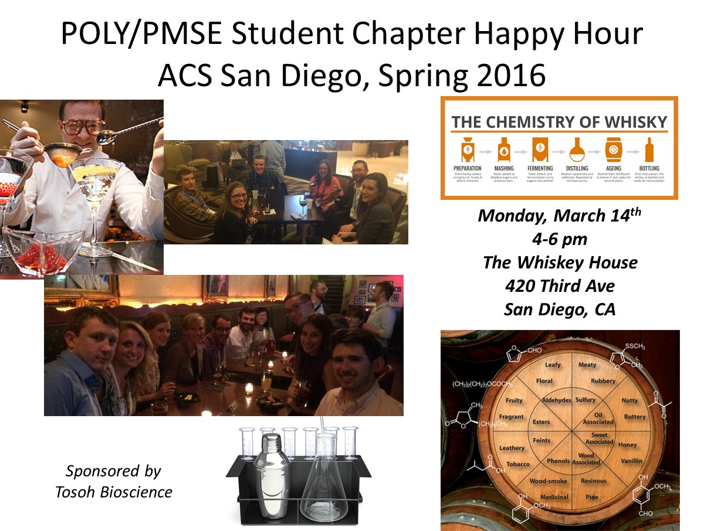
S
T
UD
E
N
T
C
HA
P
T
E
R
S

Slide 13
P
U
B
L
I
C
I
T
Y
Emily Pentzer - CWRU
Theresa Reineke- U of M
Have two boards near POLY membership desk – display two posters per day to
highlight member research at the meeting
Discussing plans to use this more broadly advertise POLY activities

Slide 14
B
UDG
E
T
Budget Item | Cost
Anniversary Pins | $3,000
Student Chapter Award | $250
Student Chapter Fund | $2,250
New Chapter Fund | $300
Scanner Rental | $700
Poster/National Meeting | $200
TOTAL | $6,700

